Slide 1
Our Data and IT Law
Martin Read

Slide 2
Disclaimer (part the first)
The author is not a lawyer of any jurisdiction
This presentation does not constitute legal advice
One should consult their own lawyer(s) for legal advice
The author does not accept liability for any loss or damage, whether physical, financial or otherwise, caused by relying on the information provided herein
The information presented herein can by no means be considered complete & error-free

Slide 3
Disclaimer (part the second)
Why do I need a disclaimer like this?
The Solicitor’s Act 1974, Courts and Legal Services Act 1990
Any unqualified person practising law… up to 2 years in prison, possible fine
In Tort, if a person relies on information given by a specialist & incurs losses, he/she may be able to sue the specialist for the losses.

Slide 4
Interesting counterpoint
Would anybody do anything similar prior to presenting a lecture on an aspect of Business or IT?
If, for example, an archaeology lecturer turned up to do an IT lecture…
Why should you not have similar expectation of this “profession”?

Slide 5
What do we mean by Ethics?
Ethics (or moral philosophy) involves:
Systematising
Defending
Recommending
concepts of right and wrong behaviour
Note: morals = ethics - same word, meaning custom/character

Slide 6
Ethical principles
Where do our ethical principles come from & what do they mean? Are they merely social inventions?
To arrive at moral standards that regulate right & wrong conduct
Examine specific controversial issues, such as animal rights,
environmental concerns, homosexuality/transexuality, capital punishment, etc

Slide 7
What do we mean by Ethics in the context of IT?
At the first level, a minimal morality?
Set of human values shared by our common humanity E.g. - don’t lie, don’t cheat, don’t steal, don’t hurt others... (commitment to fair play and integrity?)
At the second level, a professional morality?
Specific behavioural responsibility relating to IT development (commitment to quality?)
At the third level, an ‘environmental’ morality?
Set of values due to care required towards people affected by the professional’s work? (commitment to the public well being?)

Slide 8
The Responsibility of the IT Professional
To be aware of the impacts of their software or services
To be aware of the potential security flaws in their software or services
To be aware of the potential for abuse of their software or services
To acknowledge an ethical responsibility to the public

Slide 9
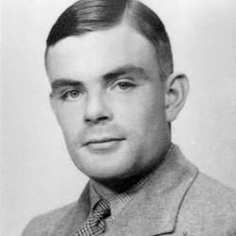
Alan Turing
Was he dyslexic?
Was he autistic?
Did he have Asperger syndrome?
‘neurodivergent’ - not diseases to be cured or problems to be overcome, simply natural variation in human genome
Didn’t make a person better or worse - just meant they thought & learned differently

Slide 10
Areas of Ethical Debate?
Get into groups of 4 or 5 people
Discuss what areas of Ethical Debate there might be within IT

Slide 11
Some Areas of Ethical Debate in IT

Slide 12
Some Areas of Ethical Debate in IT
Personal intrusion
Privacy
Deception
Security
Hacking
Reliability/goodness of fit
Inappropriate use/abuse of technology
Intellectual property
Social responsibility

Slide 13
Some other areas…
Data mining
Social networking
E-mail spam
Intellectual property
Filtering Online Content

Slide 14
Privacy
...is the claim of individuals... to determine for themselves when, how, and to what extent information about them is communicated to others...”
Alan F. Westin
Prof. of Public Law, Columbia University
But - Privacy is “new”

Slide 15

Privacy – a geek perspective
“You have zero privacy [on the Internet] anyway. Get over it.”
Scott McNealy, 1999 (CEO, SUN Microsystems)
Suggests in-built problem with the IT sector and attitudes to privacy…

Slide 16
Why is it important now?
Privacy is a social concern brought about by the interplay between business, government & technology
What the Internet & IT does:
Global access
Volume of available information
High value at very low “hit rates”

Slide 17
Your Information Footprint
Is it possible to go online without providing personal information?
“Visible” data – buying online
Disadvantaged if you don’t (PC World, Argos)
“Invisible” data – cookies, etc.
Commercially valuable information showing individual behaviour
Including Social Media, means potentially huge volumes of data (Big Data) to process

Slide 18
Privacy online?
Who is responsible to protect an individual’s privacy online?
Government
Company
Professional
Individual

Slide 19

Technology and its potential
Univ. of Wisconsin: Cover of 2000 undergraduate admissions application package
Sources for this section from Milwaukee Journal Sentinel Online
http://www.jsonline.com/news/metro/sep00/uw20091900a.asp

Slide 20

Original Photograph
Taken at a 1993 American Football game
What’s different?

Slide 21
Side by Side

Slide 22
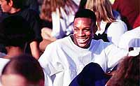
Where did he come from?

Slide 23
Why did they do it?
UW said:
Didn’t portray the image they wanted regarding diversity
Minorities make up 9% of student body
Wanted to accurately reflect something they felt was important to them and to applicants
Claimed they didn’t want to mislead..
Couldn’t find a picture that captured it all
Someone made an error of judgment…

Slide 24
And you’re showing this to us, because…???
A simple example to show the potential to defraud, mislead, etc. using technology
The rights of the individual??

Slide 25
The Challenge for Management
As IT develops and changes the law tries to change but it can be slightly out-of-step

Slide 26
Something to think about…
Every advancement in information technology is accompanied by at least one ethical quandary. From Facebook to email updates, computer users are unaware of the fine balance between ethics and profit struck by providers. Software developers, businesses and individuals must think about the rights and wrongs of using information technology every day. The fundamental issues underlying the world of information technology are the end user's expectation of privacy and the provider's ethical duty to use applications or email responsibly.
Nicholas Katers, About Ethics in Information Technology

Slide 27
FB Comments Result in sacking
Think Before You Tweet or Risk Arrest
Unencrypted Devices Pose ‘Unnecessary Risk’ for Sensitive Data
Serious Data Protection Risks for App Users
Duplicate Password Use by School Leads to data breach
University Sends Personal Data to Wrong Recipient
Teacher in FB Meltdown
Negligent Employees and Contractors Cause 36% of UK Data Breaches
University Breaches DPA by Disclosing Personal Data on Website

Slide 28
Common Scenarios
A parent requests information on son’s progress
Police request information on a student from this class
A tutor asks to see a reference supplied by her supervisor
An employer requests information on an employee’s attendance
Personal details of a student disclosed in confidence appear on FB
A staff mobile phone containing sensitive data is lost
Internal sharing of data amongst staff
External sharing of data
- ALL have DP compliance implications

Slide 29
“Laws every IT professional should be aware of”
Data Protection Act 1998
E.g. Disposing of old computers without wiping them
Computer Misuse Act 1990
“anti-hacking legislation”
Digital Economy Act 2010
Equality Act 2010
E.g. ’web accessibility’
Freedom of Information Act 2000

Slide 30
“Laws every IT professional should be aware of”
Regulation of Investigatory Powers Act 2000
Special Education Needs & Disability Act 2001
plus EU legislation, such as the Human Rights Act
(Note: this is not an exhaustive list!)

Slide 31
GDPR – Increased Scope
UK Implementation in the Data Protection Act 2018
Single set of rules for all EU nations
Applies to all organisations that process the personal data of EU citizens
Data Processors subject to and responsible for actions under GDPR
Controllers must only engage with GDPR compliant processors
Data sharing agreements required to lay out controller and processor commitments

Slide 32
DPA 1998 – Data should be…
Fairly and lawfully processed
Processed for limited purposes
Adequate, relevant and not excessive
Accurate
Not kept longer than necessary
Processed in accordance with the data subject's rights
Secure
Not transferred to countries without adequate protection

Slide 33
Concepts of the DPA 1998
Data
information being processed automatically/collected with that intention or part of a relevant filing system
Data Controller – nominated individual/organisation controlling the data
Individual can be prosecuted NOT organisation
Data Subject – individual is subject of personal data
Data Processing – obtaining, recording or holding data or carrying out any operation on it
Personal data…

Slide 34
Data Protection Act 1998
Information Commissioner's Office (ICO)
Enforcement of the DPA
Registration of data processing action
Dealing with complaints
Defines concepts related to governing of the Act
Anyone processing personal data must follow 8 principles

Slide 35
Principles of the DPA (1)
Personal data should be processed fairly & lawfully & not be processed without consent
Data subject gives consent (terms & conditions)
For sensitive personal data – explicit consent
Data must only be processed for the specified lawful purposes for which it has been obtained
i.e. the purpose for which the data controller has informed the ICO
Data should be adequate, relevant & not excessive

Slide 36
Principles of the DPA (2)
Data must be accurate & up to date
Or show reasonable attempt
Data shall not be kept for purposes longer than necessary
Retention period must be determined
Auditing/legal issues
Data shall be processed in accordance with the rights of the individual
Subjects have a right to know
Subjects have a right to withdraw in the event of damages or distress & direct marketing

Slide 37
Principles of the DPA (3)
Having regard to the state of technological development & cost of implementing any measures. Measures must ensure a level of security appropriate to -
(a) the harm that might result from such unauthorised/unlawful processing/accidental loss/destruction/damage as mentioned in the 7th principle, and
(b) the nature of the data to be protected
Not transferred outside the EEA without adequate protection

Slide 38
General Data Protection Regulation (GDPR)
New EU law governing data protection
Supersedes the Data Protection Act in May 2018
Moves the data protection goalposts slightly
Fines of up to £10m Euros or 4% of global turnover!

Slide 39
Data Protection Act 2018
Parental or legal guardian consent required to process personal data of a child below the age of 13
Data controllers must make reasonable efforts to verify consent , taking into consideration available technology without causing otherwise unnecessary processing of personal data
Age appropriate language should be used where the intended audience is a child

Slide 40
Equality Act 2010
Does not explicitly refer to computing, but…
This act subsumes the Disability Discrimination Act 2005
Section 4: Protected characteristics
A list which includes Disability
Section 6: Disability
Meanings/definitions
Link to “protected characteristics”
Section 15: Discrimination

Slide 41
Equality Act 2010
Section 20: Duty to make adjustments (for people with disabilities)
Provide information in an accessible format

Slide 42
Social Media
Anti-social Internet use
Trolling due to: gender, orientation, race, religion, disability or identification
Baiting, spamming, flaming, derogatory hashtags
Could all be an illegal activity
Serious Crime Act 2007
Virtual-mobbing/dog-piling, Doxxing, Sexting
Sexual Offences Act 2003

Slide 43
Social Media
Malicious Communications Act 1988 / Communications Act 2003
Sending communication deemed grossly offensive
Committing an act, or encouraging others to do so, may result in prosecution
Ignorance is not a defence & perceived anonymity not an escape
80% of prosecutions are successful

Slide 44
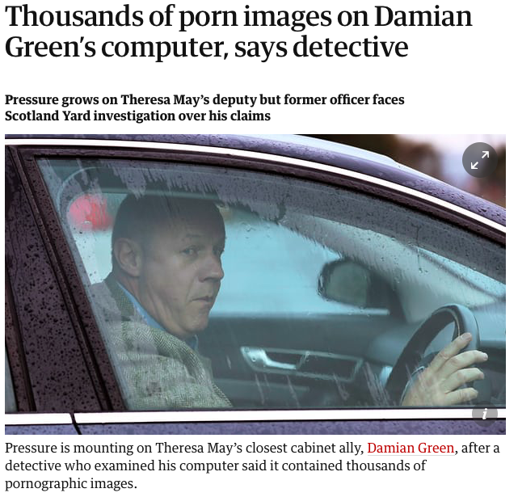
https://www.theguardian.com/politics/2017/dec/01/damian-green-thousands-of-pornographic-images-on-computer-says-detective

Slide 45
Damien Green Case
“My staff log onto my computer on my desk with my login everyday…including interns on exchange programmes. For the officer on @BBCNews just now to claim that the computer on Greens desk was accessed and therefore it was Green is utterly preposterous !!”
“In fact I often forget my password and have to ask my staff what it is.”
“Less login sharing and more that I leave my machine unlocked so they can use it if needs be. My office manager does know my login though. Ultimately I trust my team.”

Slide 46
Personal data definitions
New additions:
Online identifiers
Device identifiers
Cookie IDs
IP addresses
Pseudonymised data
Sensitive includes genetic and biometric data

Slide 47
New and expanded rights
Right to be informed
Right to erasure
Right to data portability
Right to restriction
Right to rectification
Right of access
Including additional processing details
Right to object
Right to prevent automated processing, including profiling

Slide 48
Data Protection by Design
Requirement for increased accountability and documentation of processing activities
Work DP concerns into design of all procedures, projects, systems
Good DP compliance should be default
Privacy Impact Assessments required for new activities and undertakings
Particularly for profiling, surveillance, and processing of special categories of personal data

Slide 49
Breach reporting and sanctions
Mandatory breach notification
Unless no risk to data subjects
Notify ICO within 72 hours
Sanctions of up to €20,000,000 or 4% of annual worldwide turnover

Slide 50
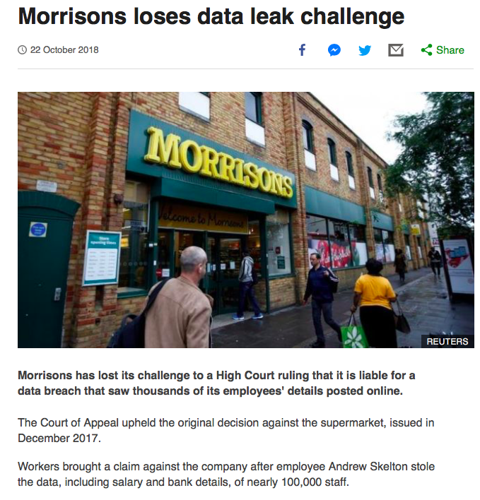
https://www.bbc.co.uk/news/business-45943735

Slide 51
Laws every professional using IT should be aware of
Data Protection Act 1998
E.g. Disposing of old computers without wiping them
Computer Misuse Act 1990
“anti-hacking legislation”
Digital Economy Act 2010
Equality Act 2010
plus ’web accessibility’ regulations 2018
Freedom of Information Act 2000

Slide 52
Laws every professional using IT should be aware of
Regulation of Investigatory Powers Act 2000
Special Education Needs & Disability Act 2001
plus EU legislation, such as the Human Rights Act
(Note: this is not an exhaustive list!)

Slide 53
Social Media
Anti-social Internet use
Trolling due to: gender, orientation, race, religion, disability or identification
Baiting, spamming, flaming, derogatory hashtags
Could all be an illegal activity
Serious Crime Act 2007
Virtual-mobbing/dog-piling, Doxxing, Sexting
Sexual Offences Act 2003

Slide 54
Social Media
Malicious Communications Act 1988 / Communications Act 2003
Sending communication deemed grossly offensive
Committing an act, or encouraging others to do so, may result in prosecution
Ignorance is not a defence & perceived anonymity not an escape
80% of prosecutions are successful

Slide 55
A little more on privacy
And why the law is needed

Slide 56
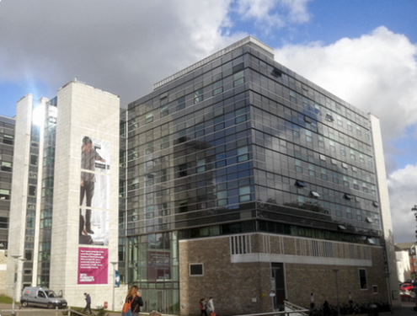

Slide 57

Who’s friends with Freddi?
In 2007, Sophos created a Facebook page for Freddi Staur
An anagram of ‘ID Fraudster’
200 people were then invited to become Freddi’s friend
By accepting the invitation a stranger was given access to their personal data

Slide 58
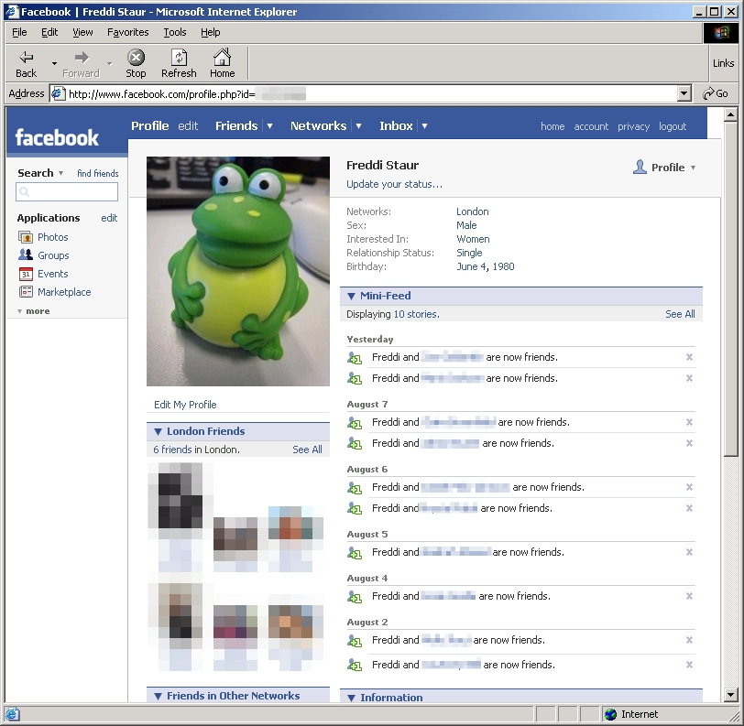
What Freddi found out
87 users responded, with 82 leaking personal information
72% divulged one or more email address
84% listed their full date of birth
87% provided details about their education or workplace
78% listed their current address or location
23% listed their current phone number

Slide 59
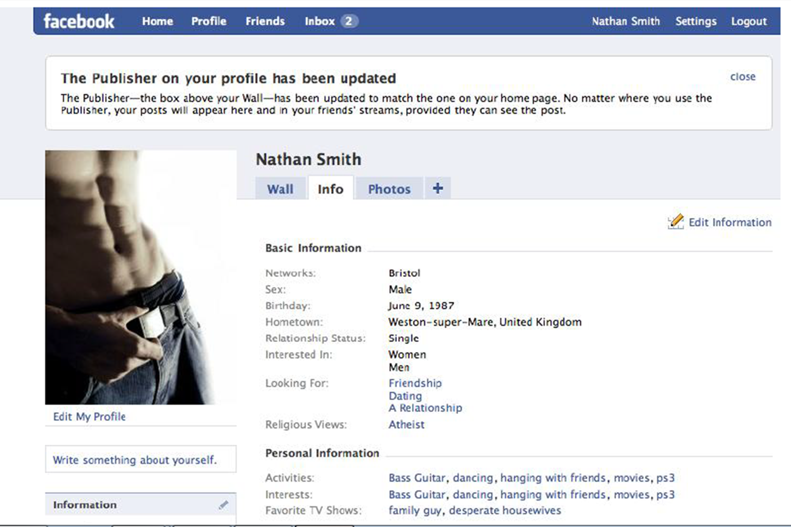

Slide 60
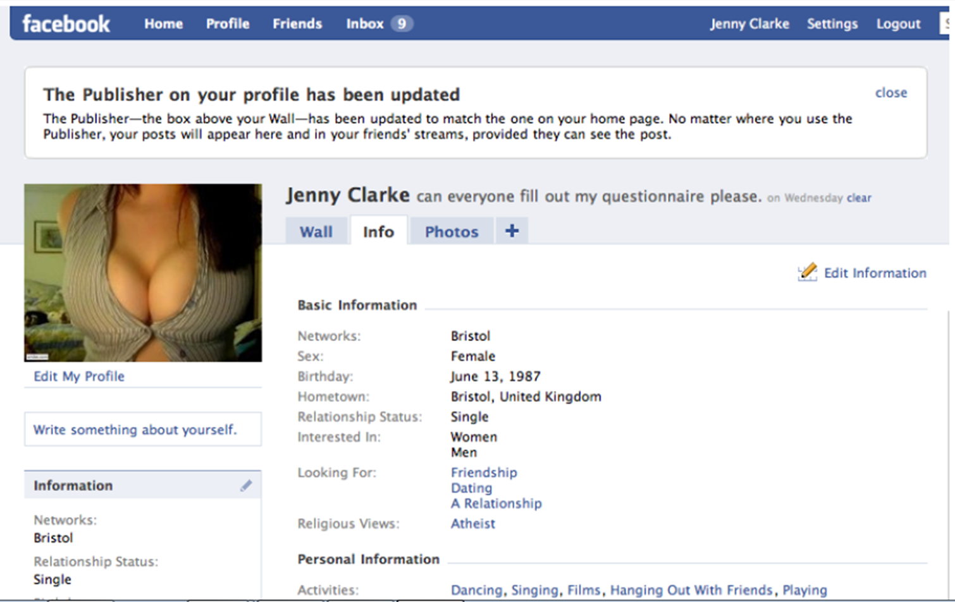

Slide 61
Methodological approach
For each profile 100 friend requests were sent to people who “also” went to their school – 50 male, 50 female in each case
Jenny
30 males accepted, 26 females accepted
Jenny also received 29 friend requests
Nathan
7 males accepted, 8 females accepted

Slide 62
Issues?
Did they do wrong?

Slide 63
The Future
Legislation is “forcing” ethical behaviour in the business world
Changes to statute books will bring this to bear in the social world
Maturing IT industry is placing far greater relevance of professionalism and ethical responsibility
Business has to react and show due diligence

Slide 64
Delete Customer
Need to consider GDPR - People need the right to be forgotten.
How might we handle this?

Slide 65
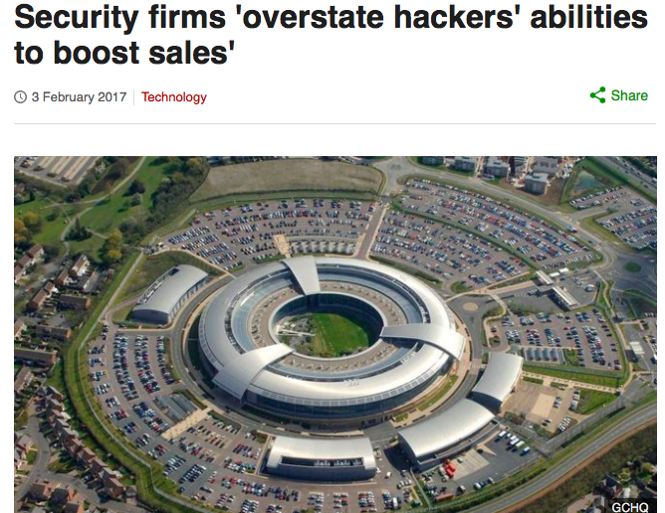
Computer security companies accused of "massively" exaggerating abilities of malicious hackers.
Firms played up hackers' abilities to help them sell security hardware & services
Dr Ian Levy, technical director of the UK's National Cyber Security Centre

Slide 66
Review
Decisions in the IT World
When to introduce new technology & when to upgrade
How do businesses evaluate new technology?
Fake News!
What online data does business hold on us & what do they do with it?
What you put on the internet/social media could get you sacked or sent to prison
Safety critical systems – should they rely on only one IT system?

Slide 67
IT in the news?
AI & Automation
Airplanes falling out of sky!
5G – digital security
High Street shops vs online shopping
Post Office accounting system
Facebook security settings
Social Media e.g. Twitter in business
Benefits/Tax online
Facial recognition software

Slide 68
Our Data and IT Law
Your Information Footprint & privacy
As IT develops & changes the law tries to change but can be slightly out-of-step
DPA & GDPR
Requirement for increased accountability & documentation by business
Equality Act 2010
plus ’web accessibility’ regulations 2018
Social media use

Slide 69
The Future
Legislation is “forcing” ethical behaviour in the business world
Changes to statute books will bring this to bear in the social world
Maturing IT industry is placing far greater relevance of professionalism & ethical responsibility
Business has to react & show due diligence

Slide 70
Some Areas of Ethical Debate in IT
Personal intrusion
Privacy
Deception
Security
Hacking
Reliability/goodness of fit
Inappropriate use/abuse of technology
Intellectual property
Social responsibility

Slide 71
The Story of MP3
MP3 protocol
Compresses digital files that store audio info
Napster
Enabled peer-to-peer file sharing
Allowed users to share music files with other users & obtain music files from other users

Slide 72
The Story of MP3
Recording companies filed a suit on grounds of copyright infringement
Napster lost the case & subsequent appeals
Question
Is it ethically right to swap copyrighted MP3 files?
Is there anything in the technology to prevent this?

